Slide 1

Early Attrition Alerts Business Services Batch Model
Autumn Li
12/28/2020

Slide 2


Why Early Attrition Alerts?
Attrited accounts share similar characteristics
Statistics empowers us to predict which accounts are more likely to attrite
The sales team could reach out to accounts that receive attrition alerts and do their best to prevent them from attrition.

Slide 3
What does the attrition model tell us about our customers?
Customers with declining trends on transaction usage or the number of active users are highly likely to attrite.
Customers with missing transaction months in past 3 months are more likely to attrite.
Customers with account issues are more likely to attrite.
Customers who have been on the books for a long time are less likely to attrite.
Customer who didn’t meet the minimum usage commitment are more likely to attrite

Slide 4
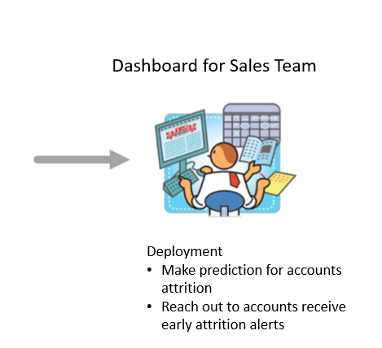
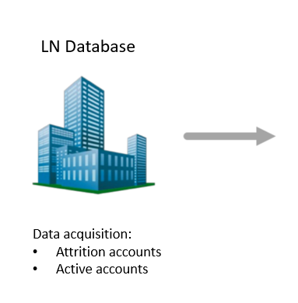
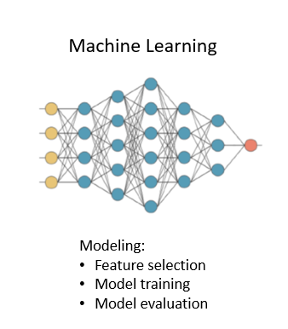
Modeling Process

Slide 5
Model Population Waterfall: Active Accounts
Whole population
All Active batch accounts created before Sept, 2020 | 1,446 accounts
Criteria 1 - Excluded platform in 'BRG', 'WCI', 'WCO' | 1,384 accounts
Criteria 2 - At least 12 months on books | 1,356 accounts
Criteria 3 - Activity year_month is between (201809, 202009) | 1,284 accounts
Criteria 4 - Have 12 months total revenue > $500 | 1,141 accounts
Criteria 5 - Have 12 months total usage > 0 | 1,078 accounts
Population criteria
Target
Final valid population accounts | 1,078 accounts

Slide 6
Model Population Waterfall: Attrited Accounts
Whole population
All Attrited batch accounts created before Sept, 2020 | 511 accounts
Criteria 1 - Excluded platform in 'BRG', 'WCI', 'WCO' | 339 accounts
Criteria 2 - At least 12 months on books | 320 accounts
Criteria 3 - Attrition year_month is between (201809, 202009) | 288 accounts
Criteria 4 - Have 12 months total revenue > $500 | 245 accounts
Criteria 5 - Have 12 months total usage > 0 | 220 accounts
Population criteria
Target
Final valid population accounts | 220 accounts

Slide 7


Population Characteristics
Average usage
Average active user
Average customer age
31,255 searches
5 active users
3,779
days
Active accounts
9,084 searches
2 active users
2,507
days
Attrited accounts

Slide 8
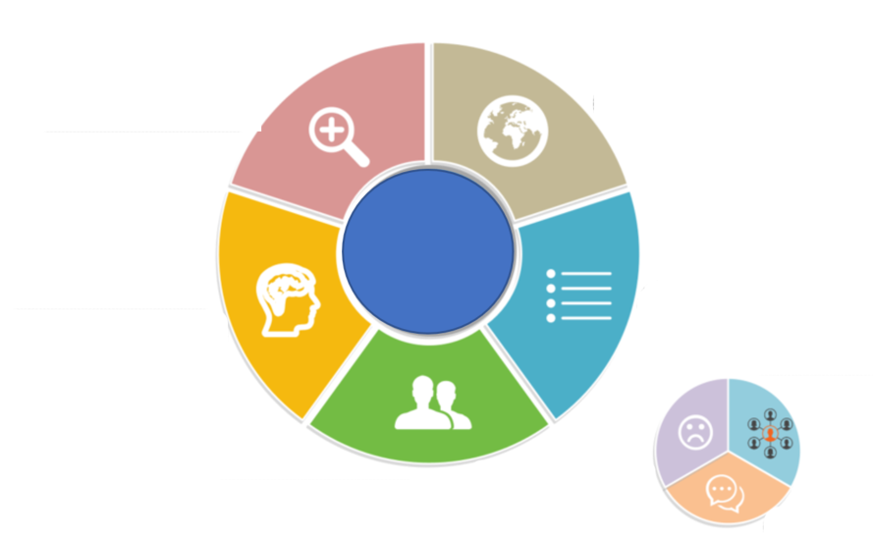
Measure Accounts Behaviors
Abnormal negative usage or user patterns
Declining negative customers
Account age
Days on books
Customer Behavior
Product usage
# of products
Abnormal small usage
Detect if a customer has usage below minimum commitments
Zero usage frequency
How active?
zero_usage_3mths
# of active users in past 3 months

Slide 9
Logistic Regression Results Interpretation
Measured Behaviors | Variable Definition | Less likely / More likely to attrite
Customer usage | Total searches in the past 3 months | More searches, less likely to attrite
Product diversity | Total products in the past 3 months | More # of products, less likely to attrite
# of Active users | Active users difference between Q3 and Q4 | More difference between active users in Q3 and Q4, more likely to attrite
Customer age | days since account creation date | More days on books, less likely to attrite
Declining negative customers | The decline of transaction usage * | More decline of the usages, more likely to attrite
Abnormal small usage | if avg_searches_3mos < min_commitments (100), then flag = 1, else 0 | More abnormal small usage, more likely to attrite
Abnormal small usage | Monthly zero usage percent in past 3 months | More zero usage, more likely to attrite
Customer service | Customer service relates to account issues | More account issues, more likely to attrite
Customer Service | Customer service relates to billing issues | More billing issues, less likely to attrite
* % difference between average Transaction Usage in 3 months leading up to attrition date and bottom 25th percentile of Transaction Usage over time

Slide 10


Logistic Regression Model Evaluation
Decile | # Attritors | # Non Attritors | Total #Customer | Attrition Rate
1 | 15 | 18 | 33 | 23.44%
2 | 13 | 19 | 32 | 20.31%
3 | 10 | 23 | 33 | 15.63%
4 | 7 | 25 | 32 | 10.94%
5 | 5 | 27 | 32 | 7.81%
6 | 3 | 30 | 33 | 4.69%
7 | 4 | 28 | 32 | 6.25%
8 | 3 | 30 | 33 | 4.69%
9 | 3 | 29 | 32 | 4.69%
10 | 1 | 32 | 33 | 1.56%
More likely to leave
How To Read this Chart:
Attrition model scores every customer based on likelihood of leaving
Customers are rank ordered based on scores and placed into deciles (Decile 1 = most likely to leave LN)
Actual counts of Attritors and Non-Attritors are used to gauge the performance of the model

Slide 11
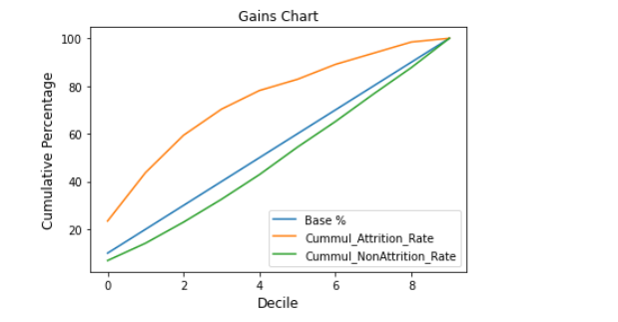
Logistic Regression Model Evaluation
70.31%
KS = 37.74
32.57%

Slide 12
Appendix

